Slide 1

Simple APIs

Slide 2
Objectives
Explain the use of the HTTP protocol using the Requests Library method.
Describe how the URL Request Response HTTP protocol works.
What is an API
API Libraries
REST API
Learn to apply simple, open-source APIs.
Discuss APIs that use some kind of artificial intelligence
Simple APIs

Slide 3
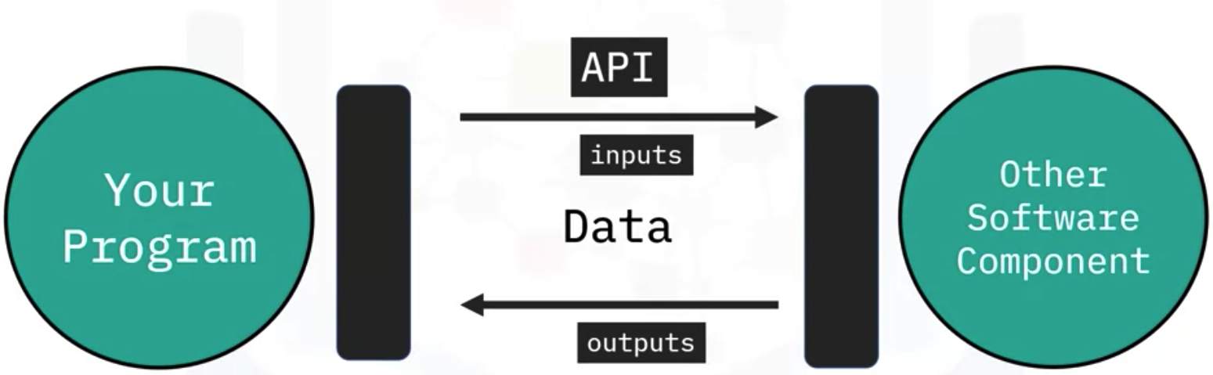
Simple APIs
You use the api to communicate with the api via inputs and outputs.
You don’t have to know how the API works, but just its inputs and outputs.
Simple APIs

Slide 4
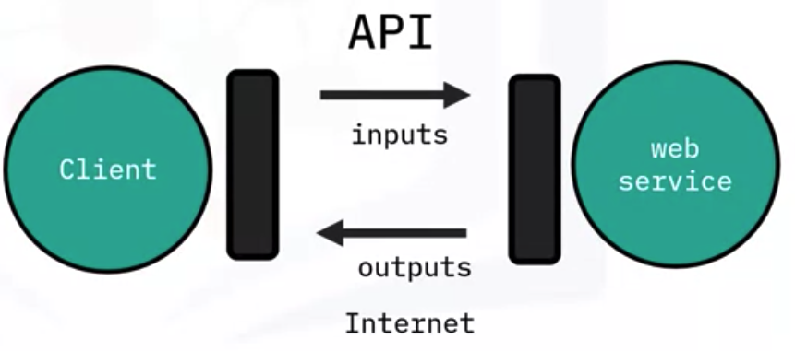
Simple APIs
REST APIs are another popular type of API; they allow you to communicate through the internet allowing you to take advantage of resources like storage, access more data,
artificial intelligent algorithms, and much more.
The RE stands for Representational, the S stands for State, the T stand for Transfer.
In rest API’s your program is called the client. The API communicates with a web service you call through the internet.
There is a set of rules regarding
  Communication
  Input or Request
  Output or Response.
Simple APIs

Slide 5
Simple APIs
HTTP methods are a way of transmitting data over the internet
The HTTP message usually contains a JSON file. This contains instructions for what operation we would like the service to perform.
This operation is transmitted to the webservice via the internet.
The service performs the operation.
The webservice returns a response via an HTTP message, where the information is usually returned via a JSON file.
This information is transmitted back to the client
Simple APIs

Slide 6
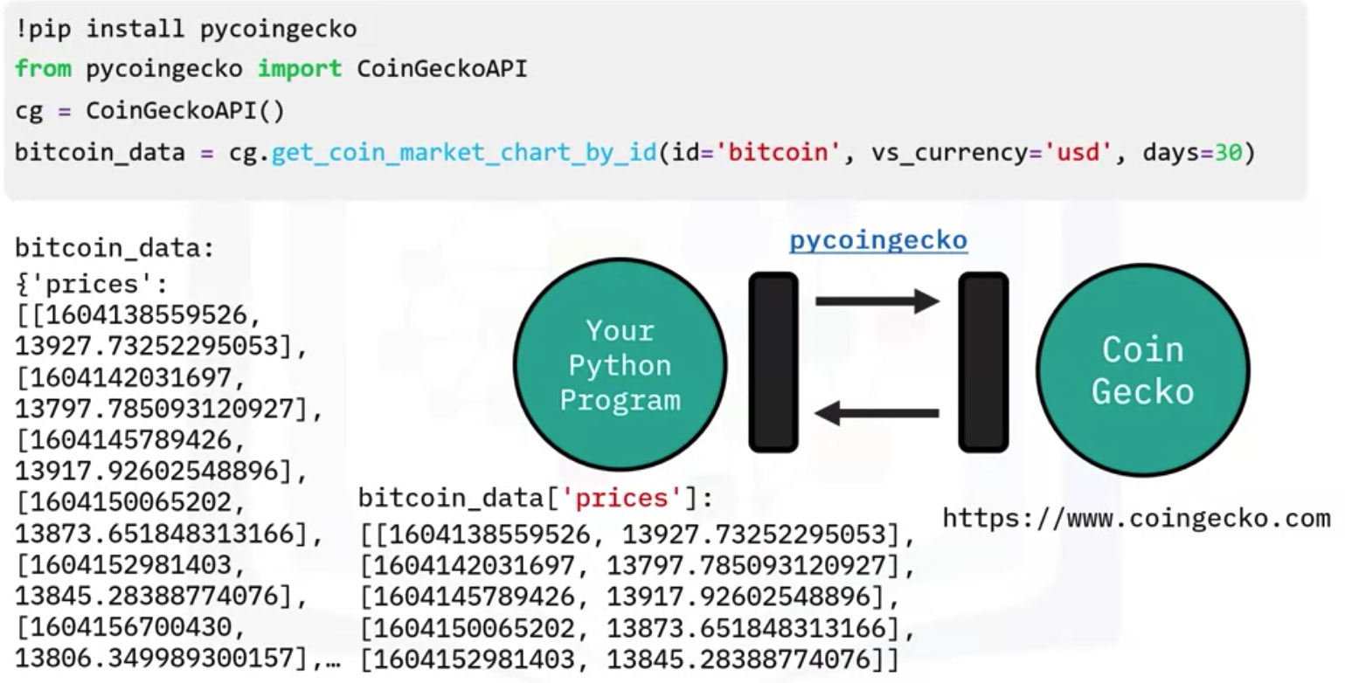
Simple APIs
We will use the Py-Coin-Gecko Python Client/Wrapper for the Coin Gecko API, updated every minute by Coin-Gecko.
Focus on prices
Simple APIs

Slide 7
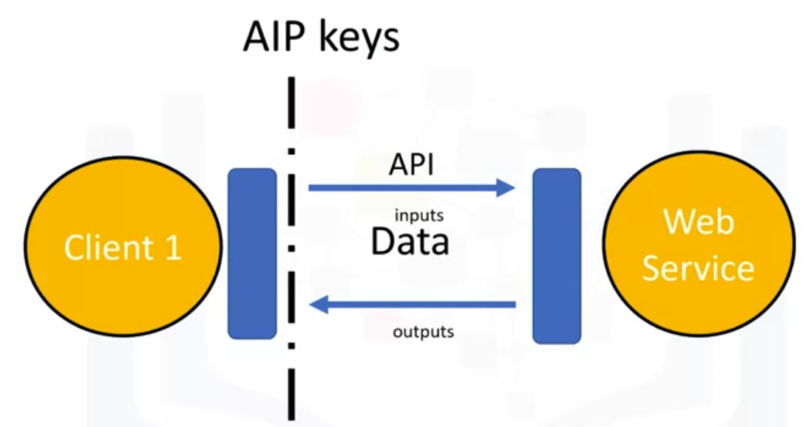
API key and endpoints
An API key as a way to access the API.
It's a unique set of characters that the API uses to identify you and authorize you
Usually, your first call to the API includes the API key. This will allow you access to the API
Simple APIs

Slide 8
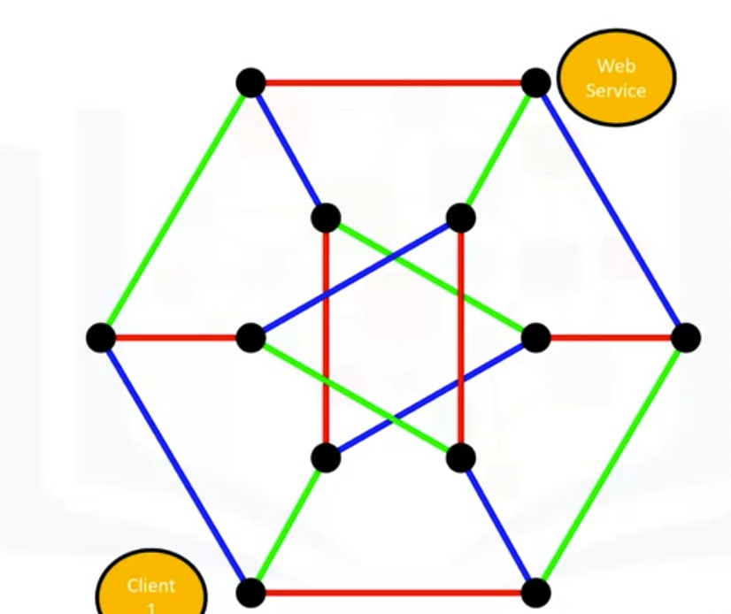
API key and endpoints
An endpoint is simply the location of the service.
It's used to find the API on the Internet just like a web address.
Simple APIs

Slide 9
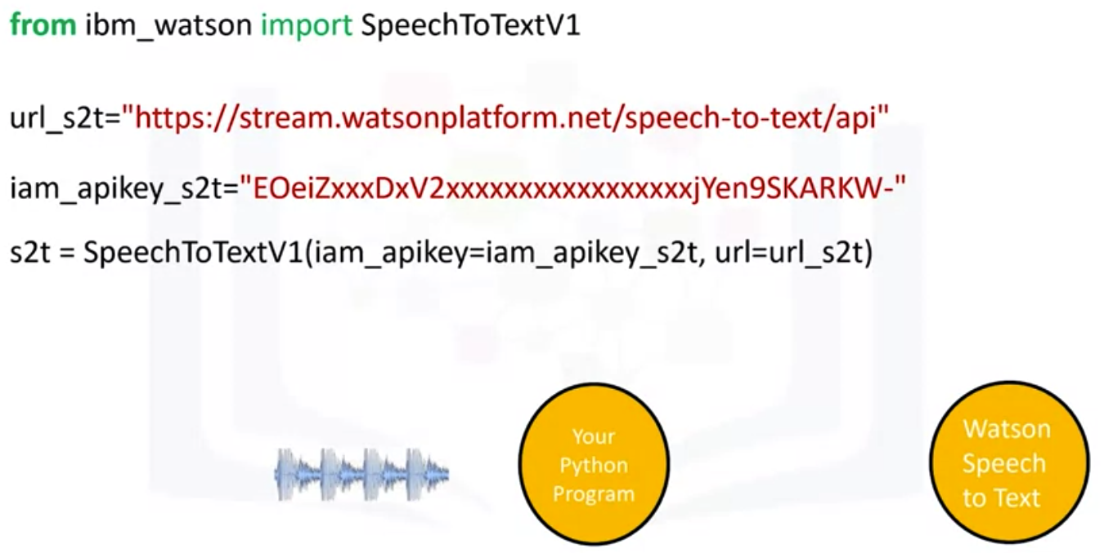
Watson speech to text
we import SpeechToTextV1 from IBM Watson.
The service endpoint is based on the location of the service instance.
We store the information in the variable url_s2t
You create a speech-to-text adapter object. The parameters are the endpoint and API key.
Simple APIs

Slide 10
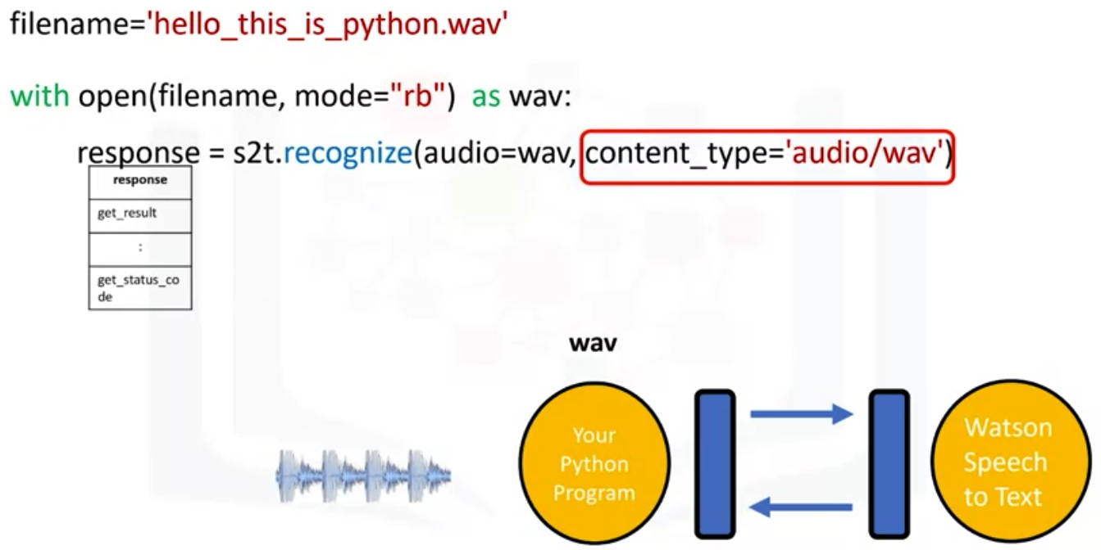
Watson speech to text
Sends the audio file to Watson Speech to Text service.
The service sends a response stored in the object response.
Simple APIs

Slide 11
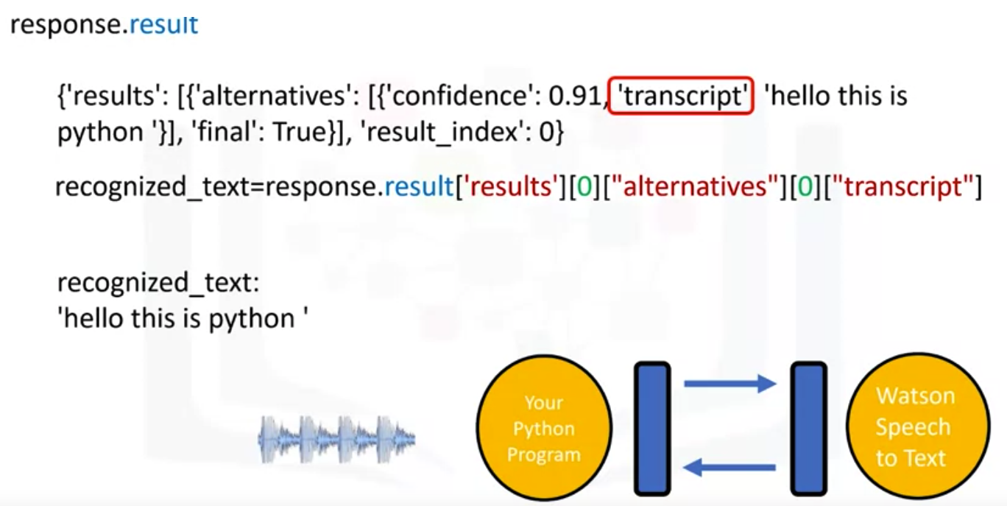
Watson speech to text
The attribute result contains a python dictionary.
The key results value has a list that contains a dictionary.
We are interested in the key transcript
Recognized_text now contains a string with a transcribed text.
Simple APIs

Slide 12
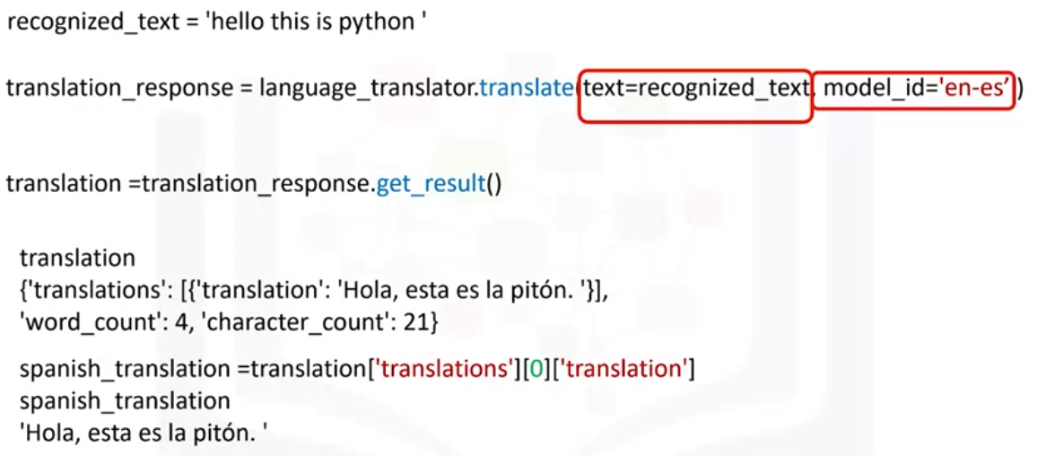
Watson Language Transkator
We import LanguageTranslatorV3 from ibm_watson.
We assign the service endpoint to the variable url_lt.
This API request requires the date of the version
We create a language translator object, LanguageTranslator
We assigned the transcribed texts to the variable to recognized_text
The result is a detailed response object. The parameter text is the text. model_id is the type of model we would like to use.
Simple APIs

Slide 13
Summary
Explain the use of the HTTP protocol using the Requests Library method.
Describe how the URL Request Response HTTP protocol works.
What is an API
API Libraries
REST API
Learn to apply simple, open-source APIs.
Discuss APIs that use some kind of artificial intelligence
Simple APIs

Slide 14
Q & A
Simple APIs

